Slide 1
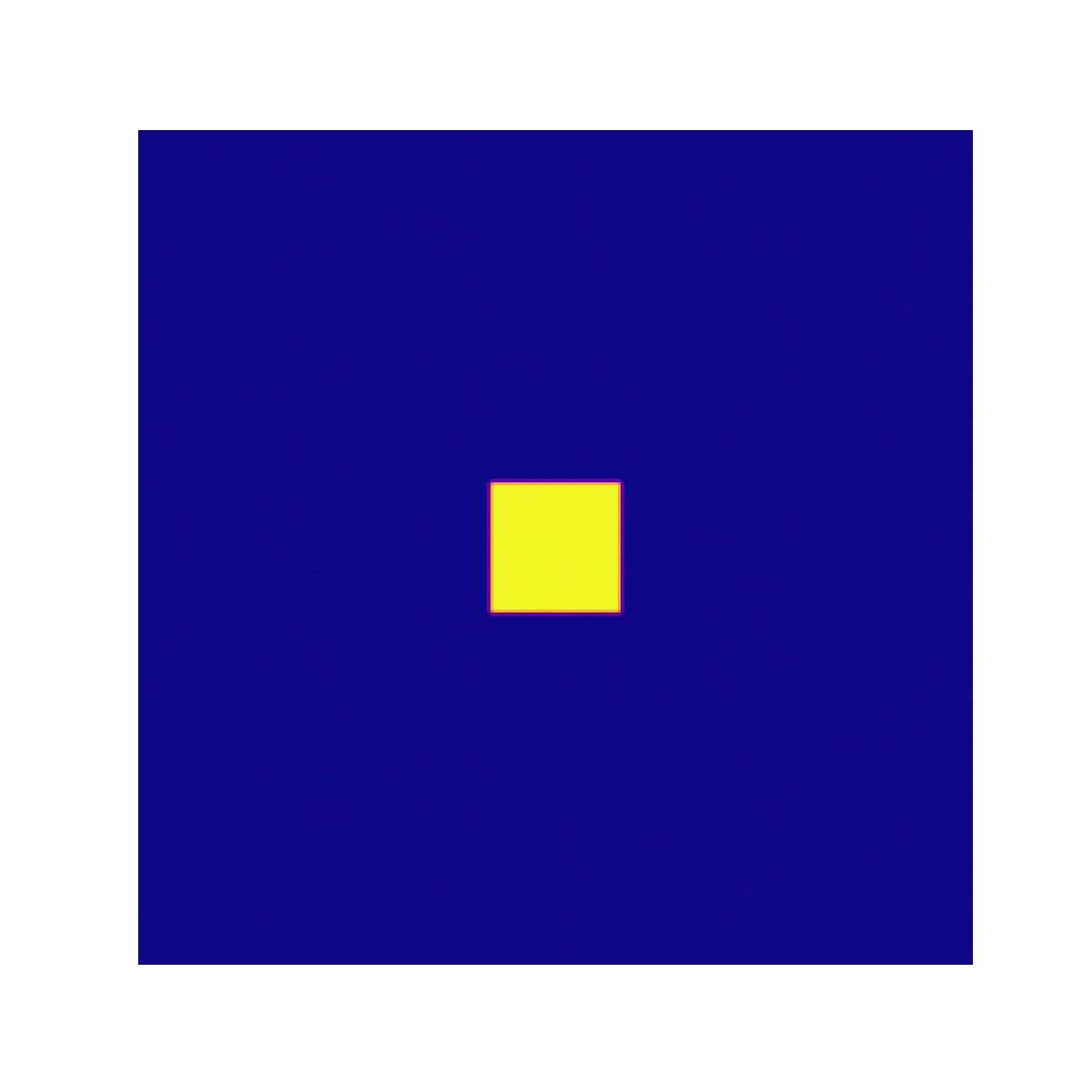
Turing patterns in reaction-diffusion systems
By Carolina and Sophia

Slide 2
Overview
Theory
Research question & motivation
Validity of results: Pearson comparison
Results: Minkowski measures and functionals
Performance evaluation
Results: Pattern production

Slide 3
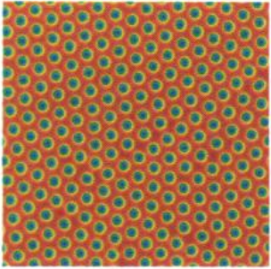
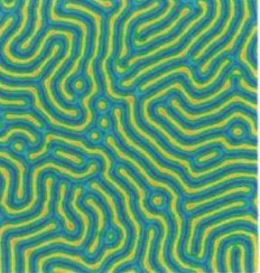

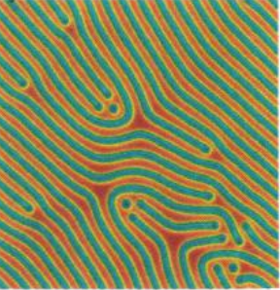
Theory: Turing Patterns
→ all due to reaction and diffusion interplay!
A
B
A
B
A
Images from Pearson’s Complex patterns in a Simple System (1993)

Slide 4
Theory: Turing Patterns
→ all due to reaction and diffusion interplay!
Diffuse fast!
Images from Pearson’s Complex patterns in a Simple System (1993)

Slide 5
Theory: Turing Patterns
→ all due to reaction and diffusion interplay!
Images from Pearson’s Complex patterns in a Simple System (1993)

Slide 6
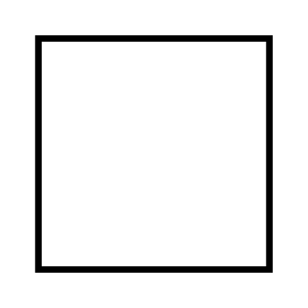

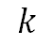
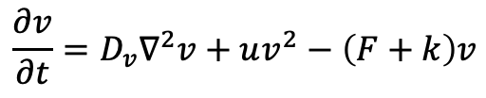
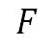
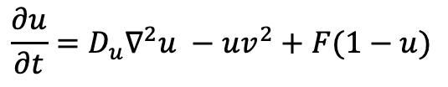
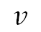
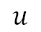
Theory: Grey-Scott model
$$\frac{∂u}{∂t}=D_{u}∇^{2}u −uv^{2}+F(1−u)$$
$$\frac{∂v}{∂t}=D_{v}∇^{2}v+uv^{2}−\left(F+k\right)v$$
$$u$$
- activator (A)
- feed rate
$$F$$
$$v$$
- inhibitor (B)
- kill rate
$$k$$
Solve using 5-point stencil in space dimension & forward Euler in time dimension
Images from Pearson’s Complex patterns in a Simple System (1993)

Slide 7
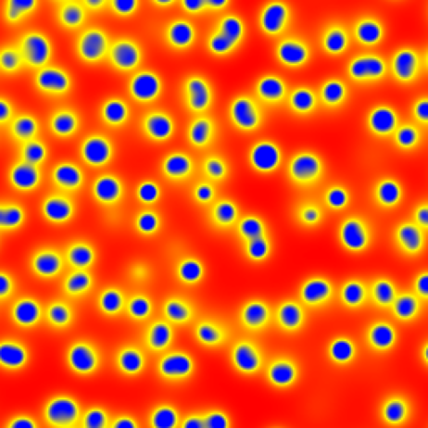
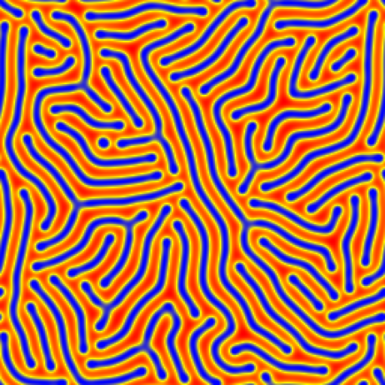
How can we quantify patterns?
VS

Slide 8
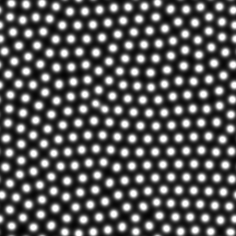
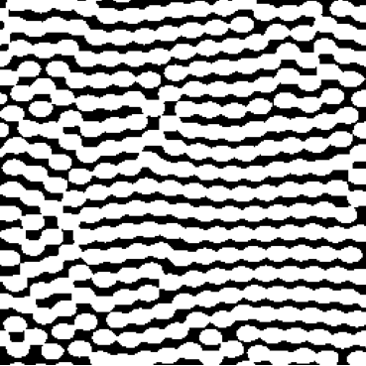
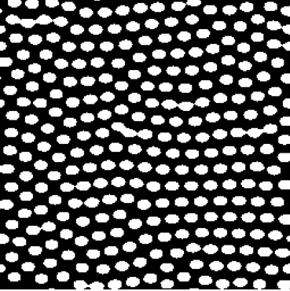
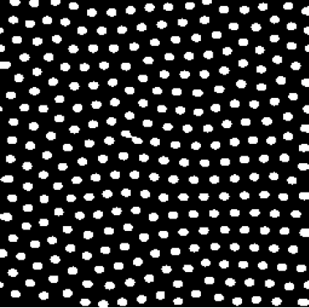
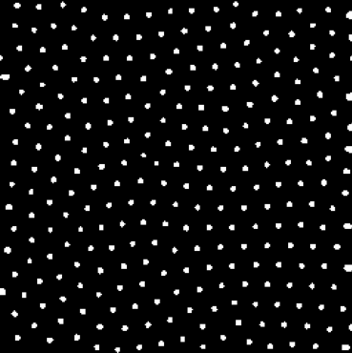
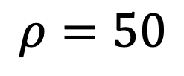
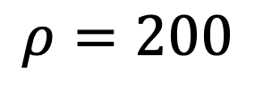
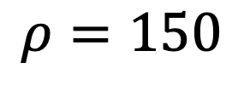
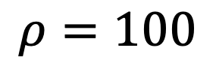
Theory: Minkowski Measures
Apply measures at each threshold grey level (1-256)
χ
$$ρ=50$$
$$ρ=100$$
s
$$ρ=150$$
$$ρ=200$$
v
White pixel area
Boundary length
Euler characteristic
Notes:
Characterize morphological features

Slide 9
Research question:
Can we reproduce characteristic Turing patterns from the Gray–Scott model as reported in Pearson (1993), and
Do our quantitative characterizations by Minkowski functionals correspond to experimental values established by Mecke (1996)?

Slide 10


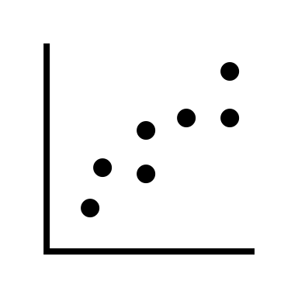
Motivation
Turing patterns can explain
pattern formation in nature!
Little research on reproducing Mecke
on modern simulations

Slide 11
Results The simulated system

Slide 12
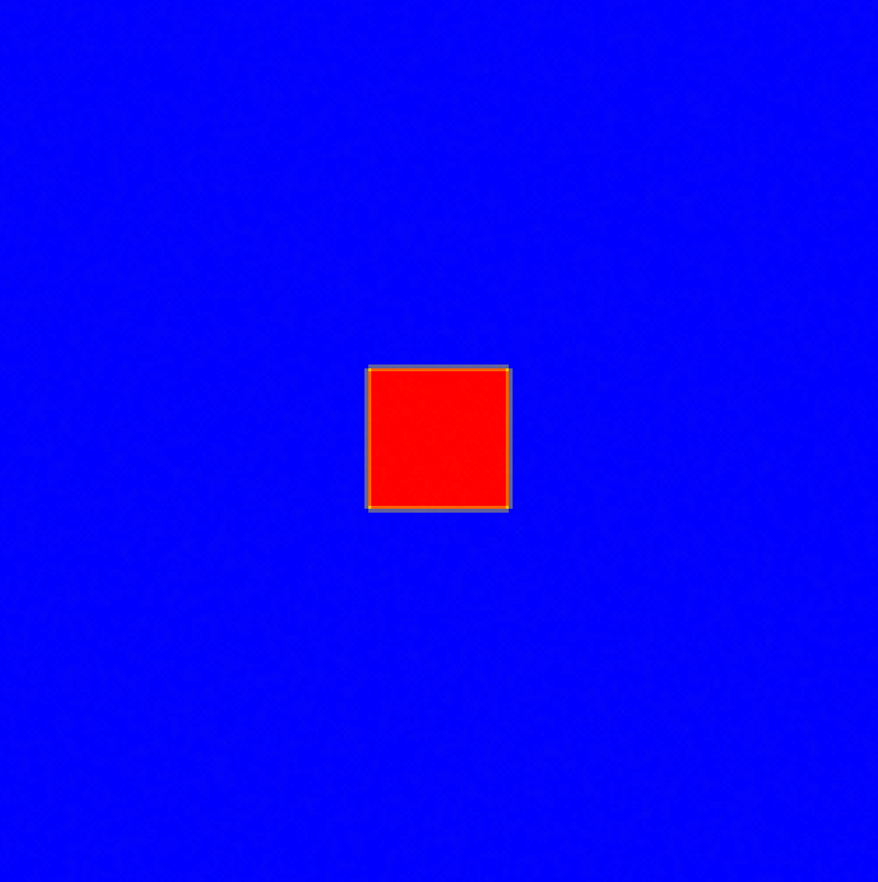
Time-evolved simulations
Simulation for stripe pattern
Simulation for dotted pattern

Slide 13
Results The Minkowski measures and functionals

Slide 14
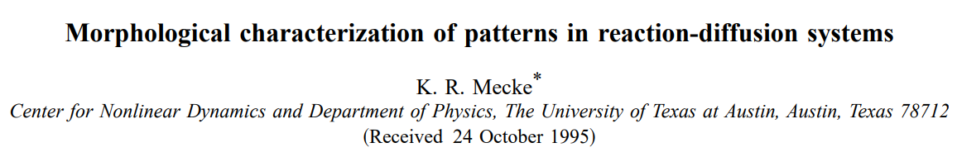
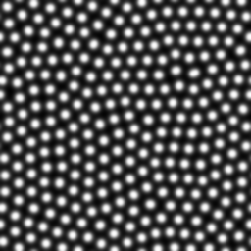
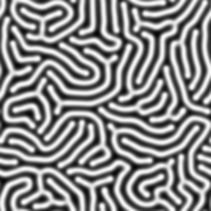
Comparing to literature
SIMULATION
v
p_{v}
s
p_{s}
Transform into functional form
χ
p_{χ}

Slide 15
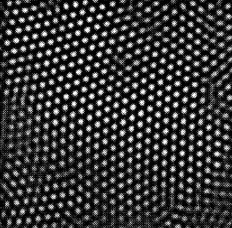
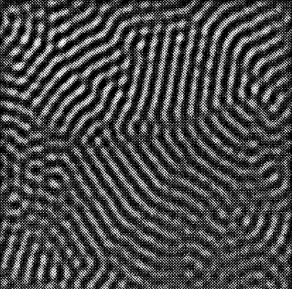
SIMULATION
EXPERIMENT
p_{v}
Dots
p_{s}
p_{χ}
Stripes
Images from Mecke’s Morphological characterization of patterns in reaction-diffusion systems (1996)

Slide 16
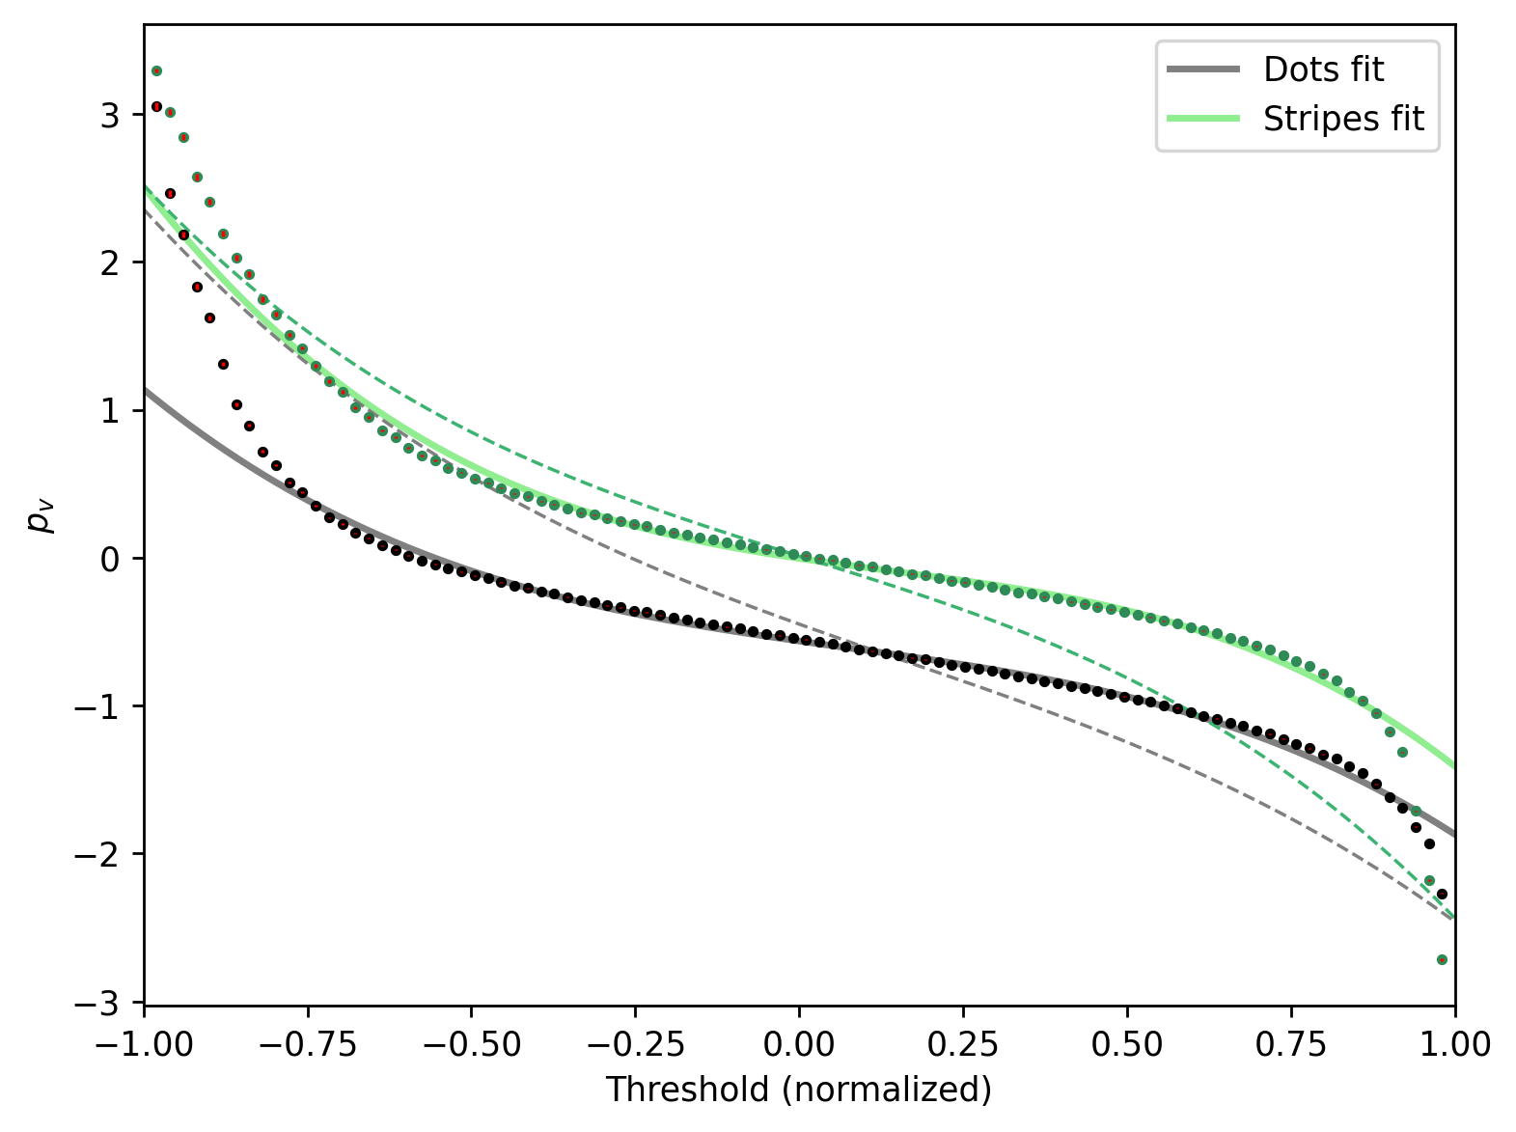
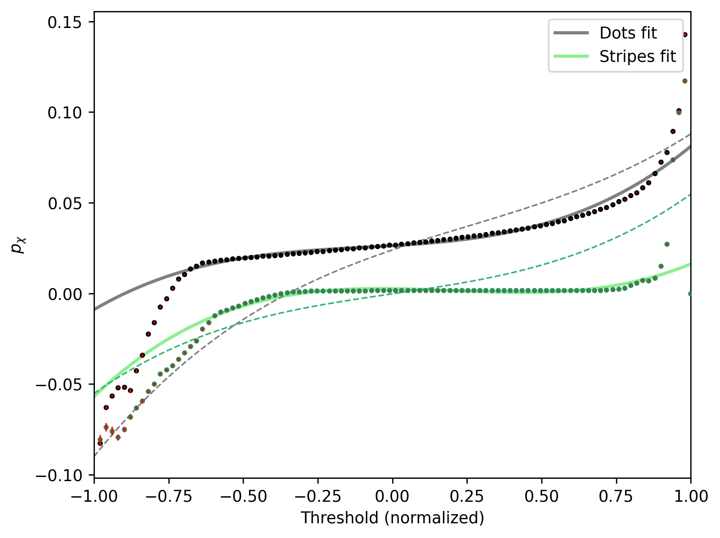


p_{v}
p_{χ}
Errors
Dots
Stripes
Dots
Stripes
Mecke
Mecke
RMS | Dots | Stripes
 | 0.118 | 0.084
RMS | Dots | Stripes
 | 0.176 | 0.137
Notes:
Dots misses Mecke reference by an average 12% of unit height
Small RMS – shape closely follows benchmark

Slide 17
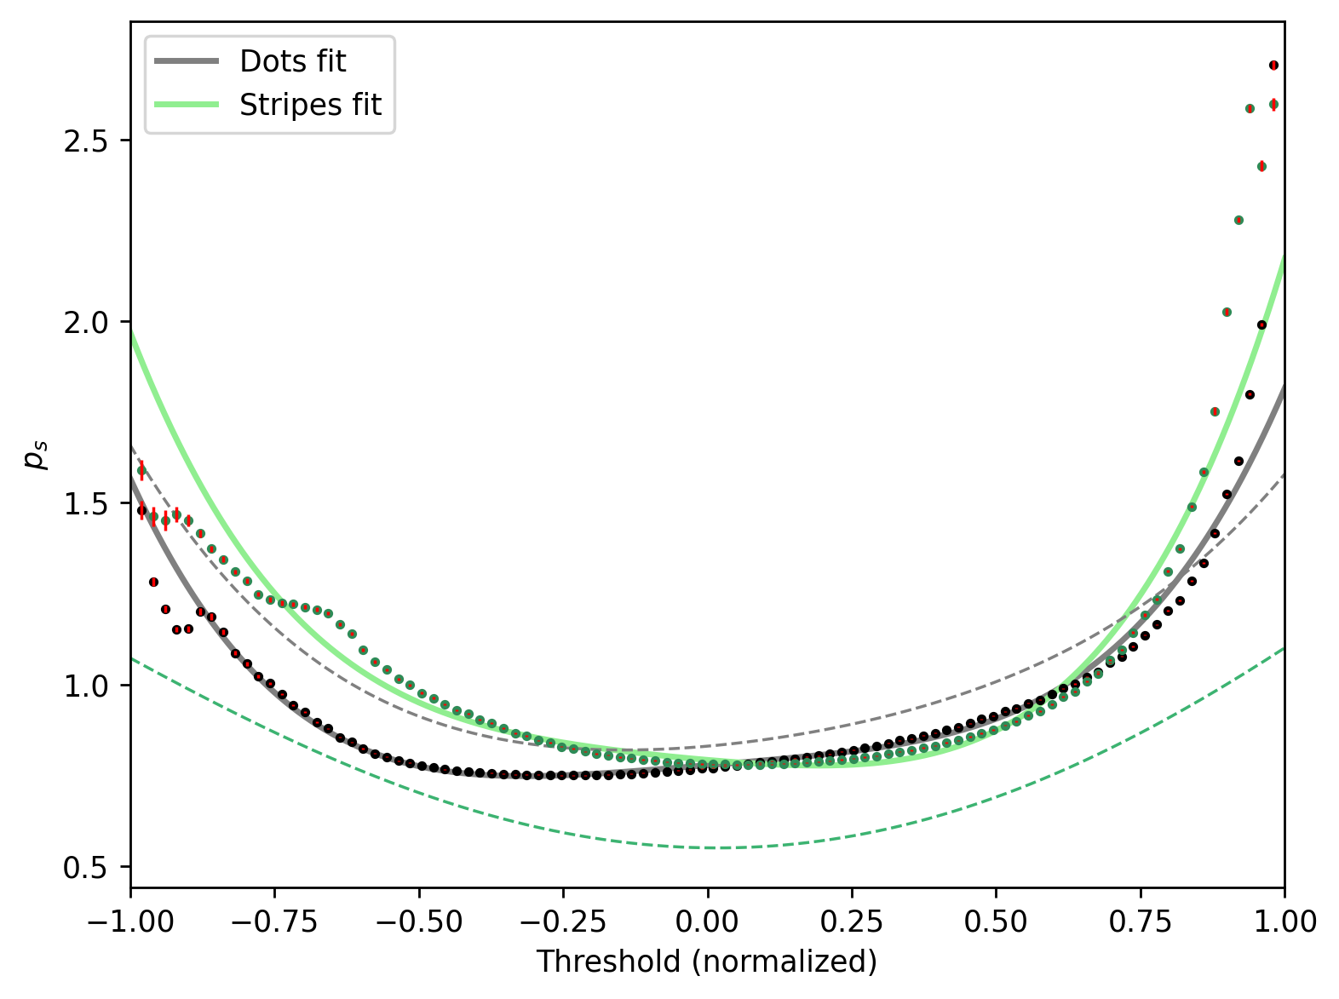
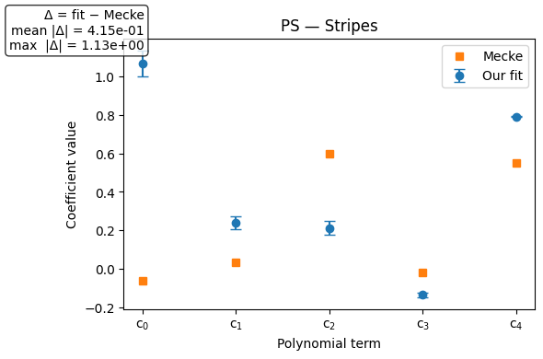
p_{s}
RMS vs Mecke
Dots | Stripes
0.131 | 0.720
Mecke
Stripes
Dots
*Coefficient errors for all fits in appendix
Notes:
Stripes are 72% away from the Mecke prediction – boundary length behaviour of simulation very different!
Ps not a good distinguisher
Because nearly every polynomial coefficient deviates from Mecke, particularly the constant term – our whole curve gets pushed up.

Slide 18
Validity of simulation results Comparing our functionals to Pearson’s (1993)

Slide 19
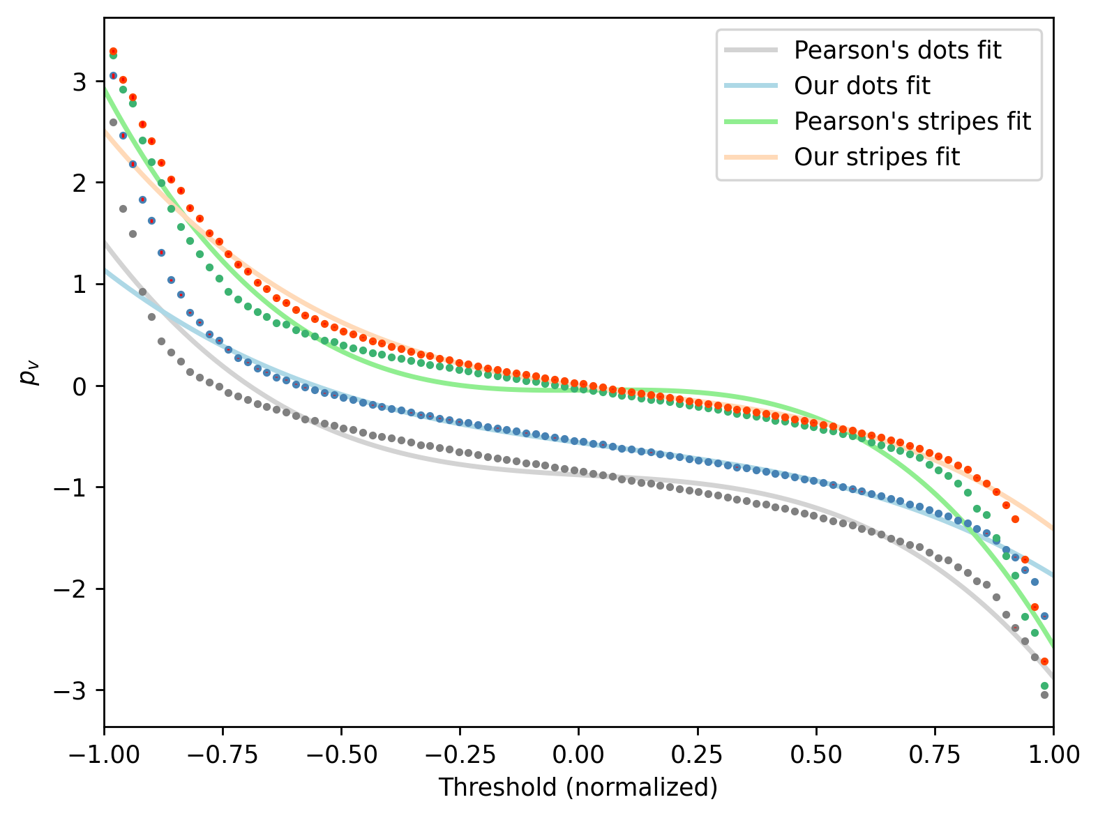
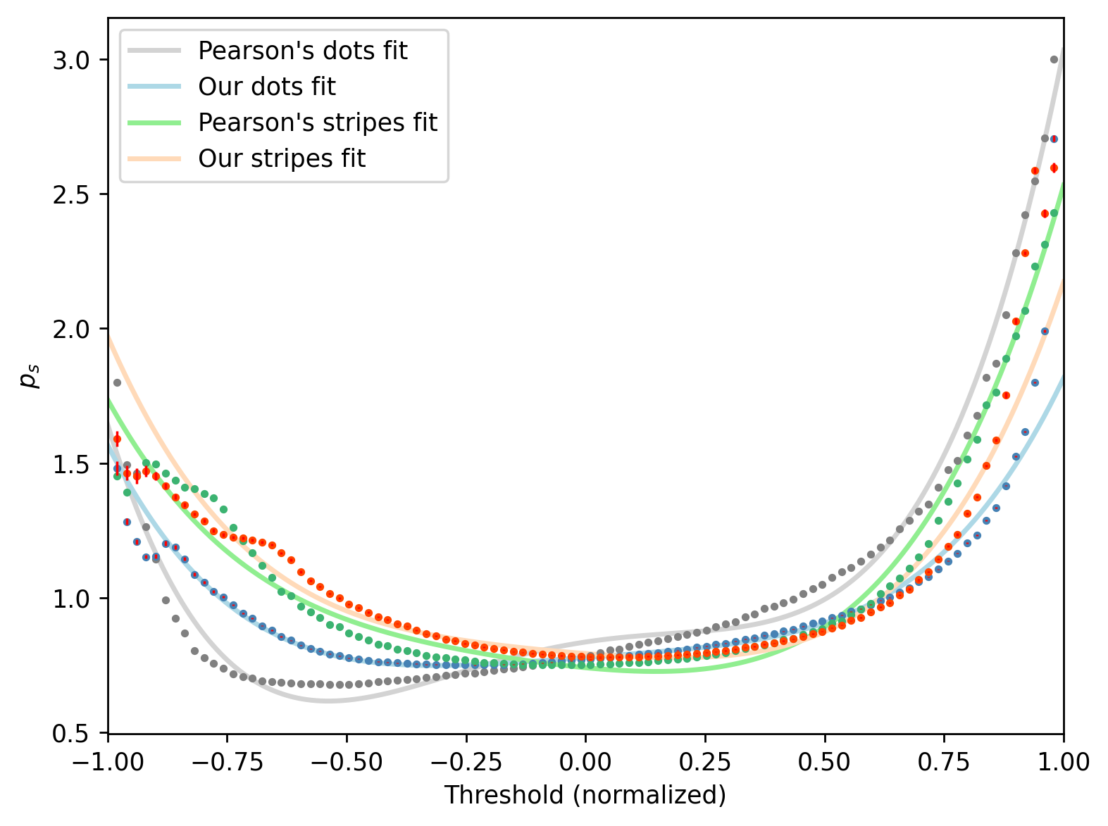
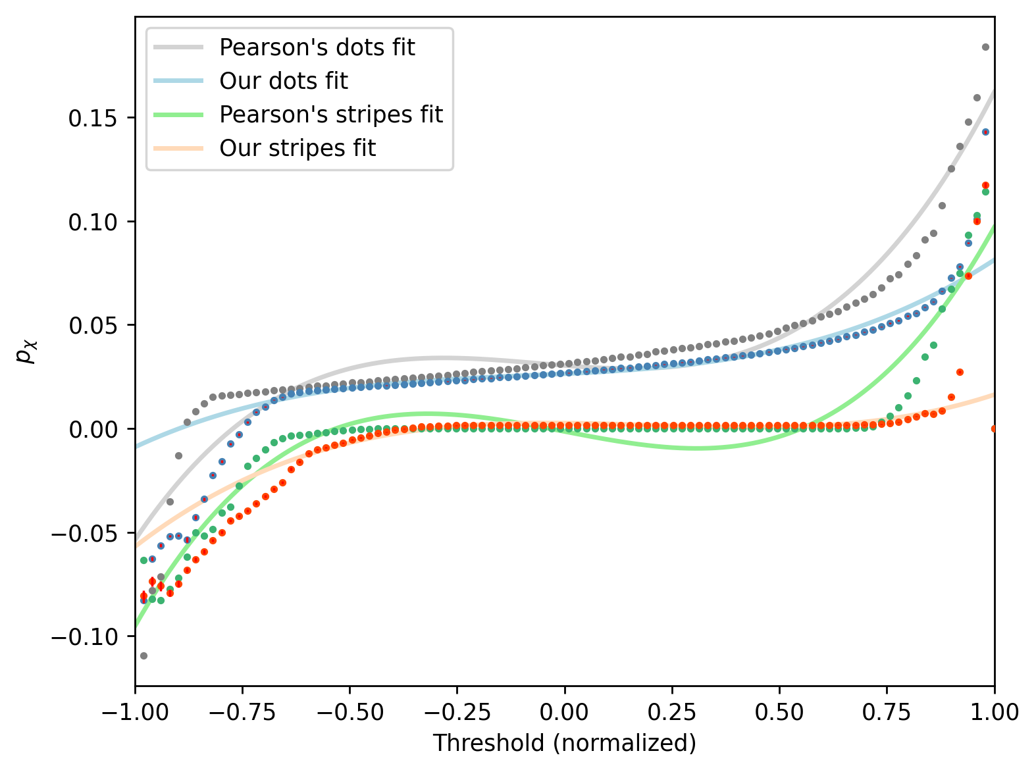
p_{v}
p_{s}
p_{χ}

Slide 20
Statistical analysis: Pearson’s vs. our functionals
p_{v}
RMS
Dots | Stripes
0.131 | 0.080
0.283 | 0.083
0.258 | 0.290
p_{s}
Orientation agreement
Same-sign | Pearson corr. coeff.
1.000 | 0.851
0.698 | 0.531
1.000 | 0.893
p_{χ}

Slide 21

Performance evaluation
21 s
np.zeros
chain
tqdm (progress bar)
~0.23 s
~0.15 s
31 s

Slide 22

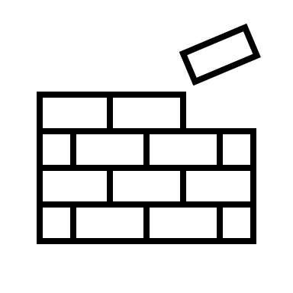


Performance evaluation
Faster convolution: FFT
Disable progress-bar
Numba friendly code

Slide 23

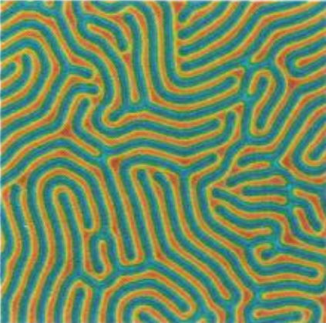
Conclusion
1
2
3
p_{v}
p_{s}
p_{χ}

Slide 24
Thank you for listening!

Slide 25
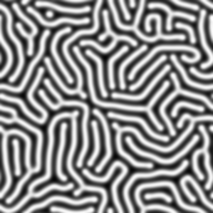
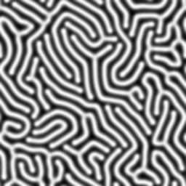
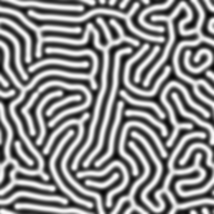
Extra slides: Errors
Different RNG seeds for each run – 20 runs, mean and std error for p, v and chi, as well as p_v, p_s, p_chi

Slide 26
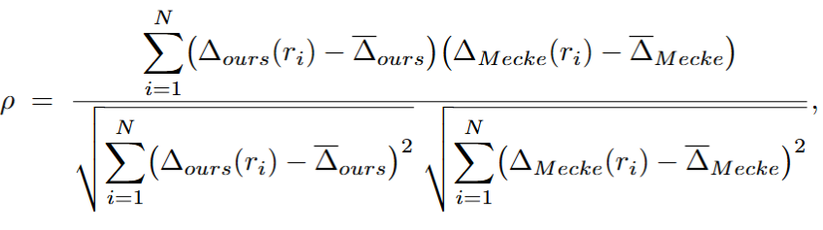
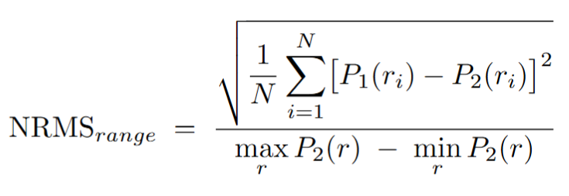
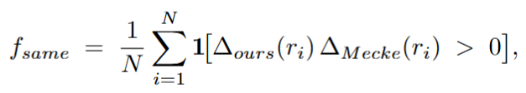
Polynomial analysis
Normalised RMS to compare p_chi with the others;
a dimensionless ‘fraction-of-full-height’ error
Pearson coefficient – measures linear relationship between two variables; shows us global consistency of fluctuations around the mean (mean-centered, d/n take into account vertical offsets).
Cosine angle between two sampled difference vectors
Fraction of thresholds whose orientation matches

Slide 27
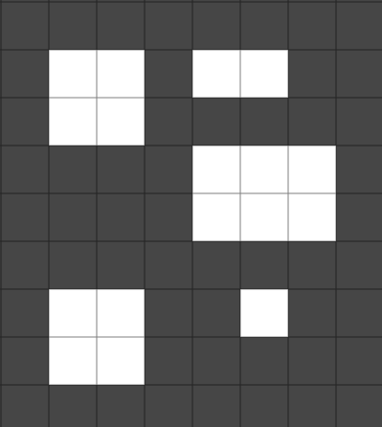

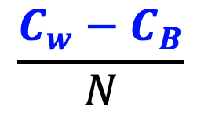
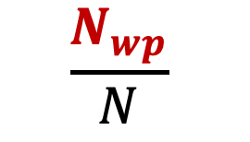
Theory: Minkowski Measures
Geometric measures for morphological differences
$$\frac{N_{wp}}{N}$$
$$\frac{B_{l}}{N}$$
$$\frac{C_{w}−C_{B}}{N}$$
1
2
5
6
#2
3
4
#1
7
8
9
#3
10
11
12
#1
14
13
17
#4
#5
16
χ
15
v
s
White pixel area
Boundary length
Euler characteristic

Slide 28
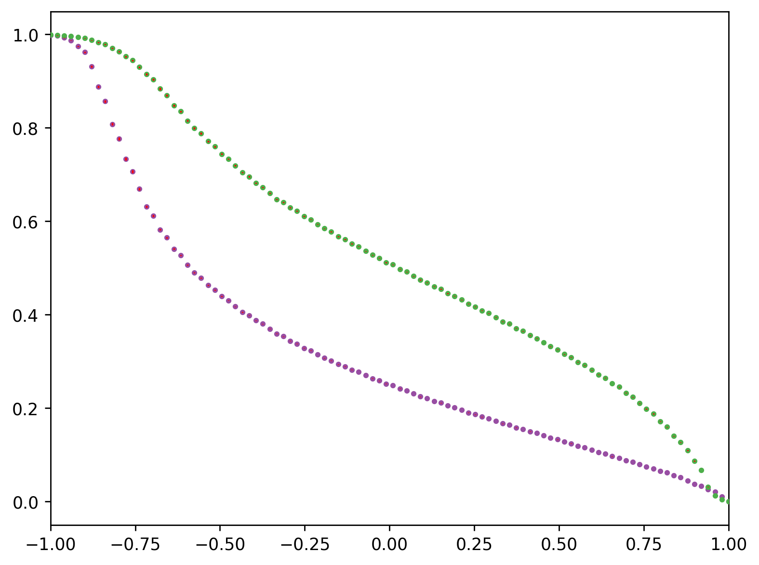
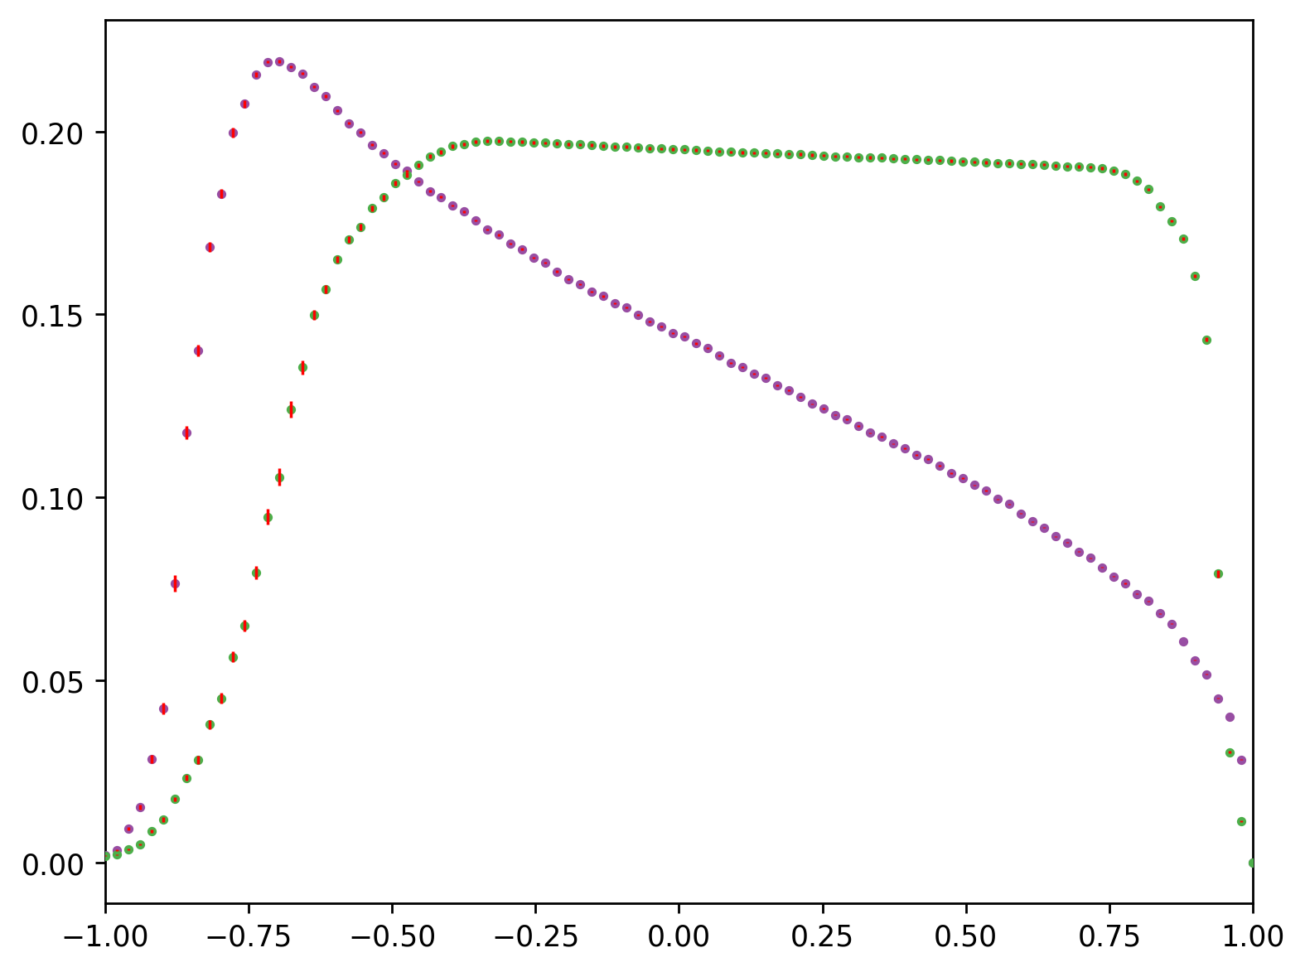


White pixel area
Boundary length
Stripes
Errors
v
Stripes
s
Dots
Dots
Errors
$$ρ$$
$$ρ$$

Slide 29
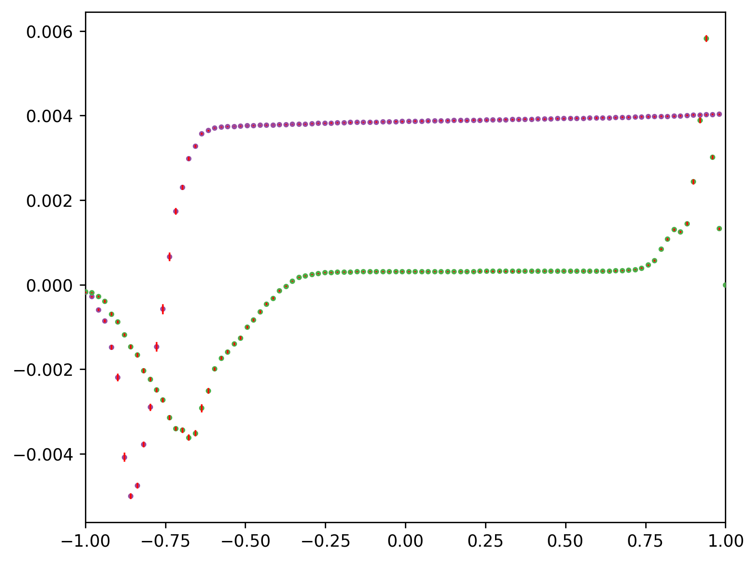


Difference in # of components
Dots
χ
Stripes
Errors
$$ρ$$

Slide 30

Extra slides: Functional forms
Chosen by Mecke because the functionals occur in many fields of physics. Direct connection to reaction-diffusion systems unclear.
Allows for polynomial fitting – and coefficients that depend on experimental conditions

Slide 31







Stripes
Stripes
Shape due to inhomogeneities in experimental photos?

Slide 32
p_{v}
RMS | Dots | Stripes
 | 0.118 | 0.084
Orientation agreement
Same-sign | Pearson corr. coeff.
1.000 | -0.510
0.278 | -0.390
0.764 | 0.151
p_{s}
RMS | Dots | Stripes
 | 0.131 | 0.720
RMS | Dots | Stripes
 | 0.176 | 0.137
p_{χ}

Slide 33




Polynomial coefficient errors
p_{v}

Slide 34



Polynomial coefficient errors
p_{s}

Slide 35




Polynomial coefficient errors
p_{χ}

Slide 36
Extra slides: All Pearson plots

Slide 37

χ

Slide 38

v

Slide 39

s

Slide 40
p_{v}

Slide 41
p_{s}

Slide 42
p_{χ}

